Slide 1
Stats and R basics
Prachi Samant

Slide 2
Why Data Science?
Data is the oil for today's world. With the right tools, technologies, algorithms, we can use data and convert it into a distinctive business advantage
Data Science can help you to detect fraud using advanced machine learning algorithms
It helps you to prevent any significant monetary losses
Allows to build intelligence ability in machines
You can perform sentiment analysis to gauge customer brand loyalty
It enables you to take better and faster decisions
Helps you to recommend the right product to the right customer to enhance your business

Slide 3
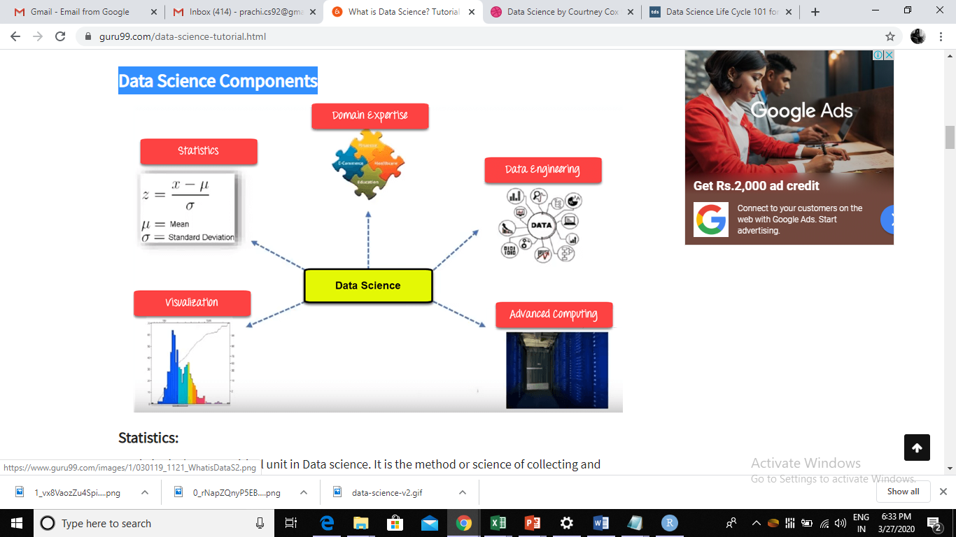
Data Science Components

Slide 4
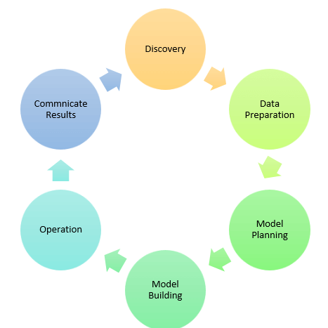
Data Science Process

Slide 5
Data Science Jobs Roles
Data Scientist: professional who manages enormous amounts of data
Data Engineer: He develops, constructs, tests, and maintains architectures like large scale processing system and databases.
Data Analyst: responsible for mining vast amounts of data
Data Admin: Data admin should ensure that the database is accessible to all relevant users.

Slide 6
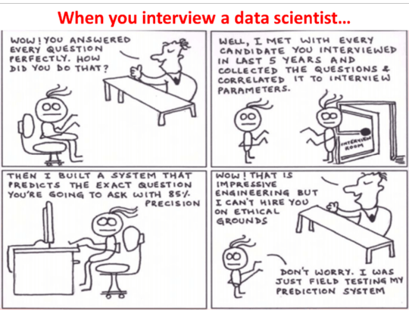

Slide 7
we typically use data science to answer five types of questions:
How much or how many? (regression)
Which category? (classification)
Which group? (clustering)
Is this weird? (anomaly detection)
Which option should be taken? (recommendation)

Slide 8
Applications
Internet Search : to search a specific result within a fraction of a second
Recommendation Systems : "suggested friends" on Facebook or suggested videos" on YouTube
Image & Speech Recognition : Speech recognizes system like Siri, Google assistant, Alexa runs on the technique of Data science
Gaming world : It can update itself when you move to higher levels.
Fraud and Risk Detection.
Targeted Advertising
Airline Route Planning

Slide 9
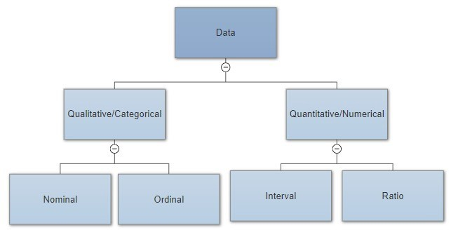
Types of DATA

Slide 10
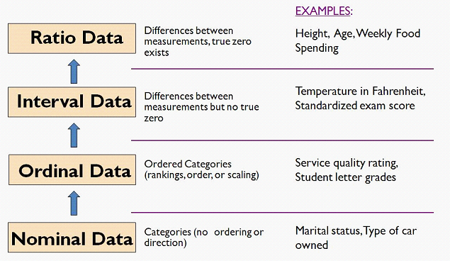

Slide 11
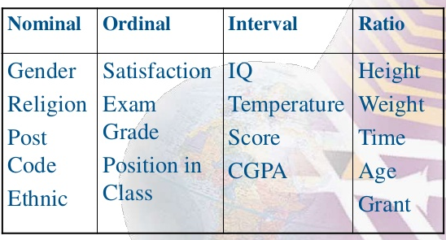

Slide 12
Interval scale and ratio scale are the two variable measurement scales where they define the attributes of the variables quantitatively.
The difference between interval and ratio scales is that, while interval scales are void of absolute or true zero for example temperature can be below 0 degree Celsius (-10 or -20), ratio scales have a true zero value, for example, height or weight it will always be measured between 0 to maximum but never below 0.

Slide 13
measure of central tendency
A measure of central tendency is a single value that attempts to describe a set of data by identifying the central position within that set of data.
As such, measures of central tendency are sometimes called measures of central location.
They are also classed as summary statistics.
The mean, median and mode are all valid measures of central tendency

Slide 14
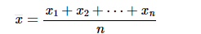
Mean (Arithmetic)
The mean is equal to the sum of all the values in the data set divided by the number of values in the data set. So, if we have n values in a data set and they have values x1,x2,x3,….,xn the sample mean is denoted as
mean is not often one of the actual values that you have observed in your data set.

Slide 15
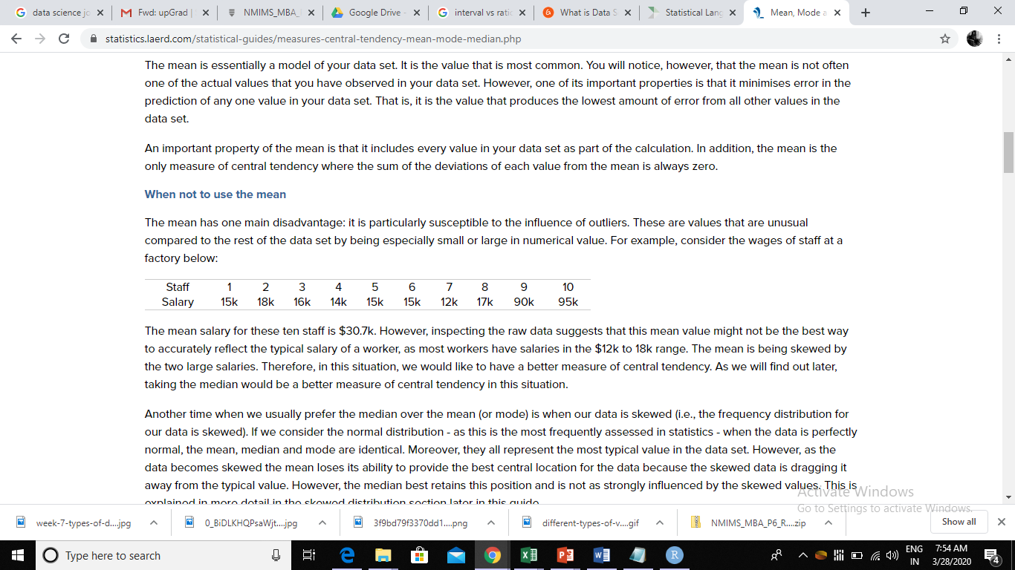
When not to use the mean
The mean salary for these ten staff is $30.7k.
However, inspecting the raw data suggests that this mean value might not be the best way to accurately reflect the typical salary of a worker, as most workers have salaries in the $12k to 18k range.
The mean is being skewed by the two large salaries.

Slide 16
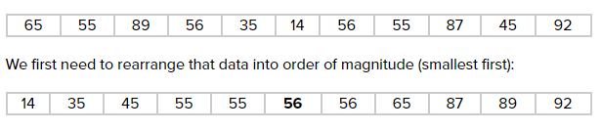
Median
The median is the middle score for a set of data that has been arranged in order of magnitude. The median is less affected by outliers and skewed data.

Slide 17
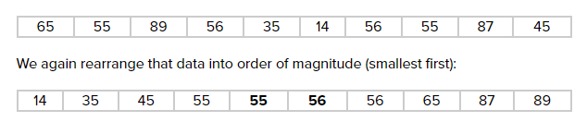
Median for even number of observations
now we have to take the 5th and 6th score in our data set and average them to get a median of 55.5.
The median is less affected by outliers and skewed data than the mean
The median cannot be identified for categorical nominal data.

Slide 18
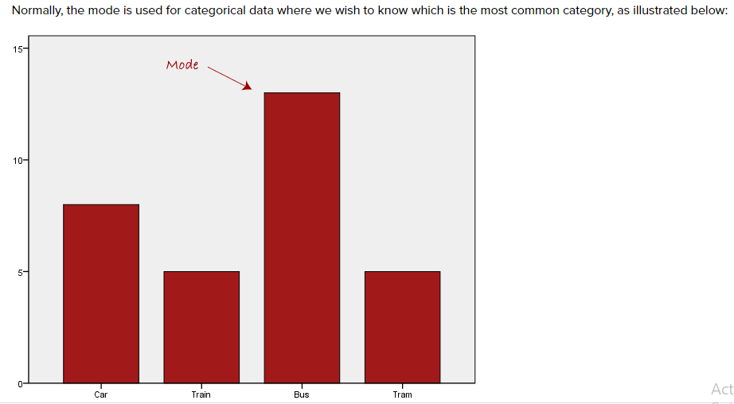
Mode
The mode is the most frequent score in our data set.

Slide 19
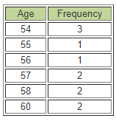
Consider this dataset showing the retirement age of 11 people, in whole years: 54, 54, 54, 55, 56, 57, 57, 58, 58, 60, 60
The mode has an advantage over the median and the mean as it can be found for both numerical and categorical (non-numerical) data.
It is also possible for there to be more than one mode for the same distribution of data, (bi-modal, or multi-modal).
In some cases, particularly where the data are continuous, the distribution may have no mode at all (i.e. if all values are different).

Slide 20
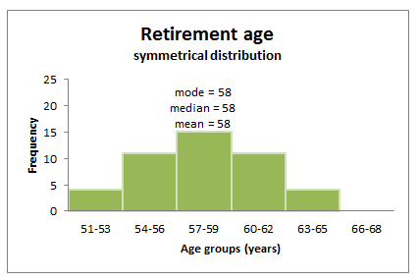
shape of a distribution
Symmetrical distributions: When a distribution is symmetrical, the mode, median and mean are all in the middle of the distribution.

Slide 21
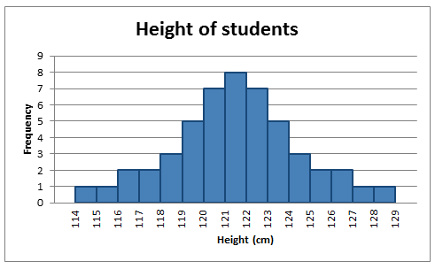
In a symmetrical distribution the two sides of the distribution are a mirror image of each other. A normal distribution is a true symmetric distribution of observed values. When a histogram is constructed on values that are normally distributed, the shape of columns form a symmetrical bell shape. This is why this distribution is also known as a 'normal curve' or 'bell curve’.

Slide 22
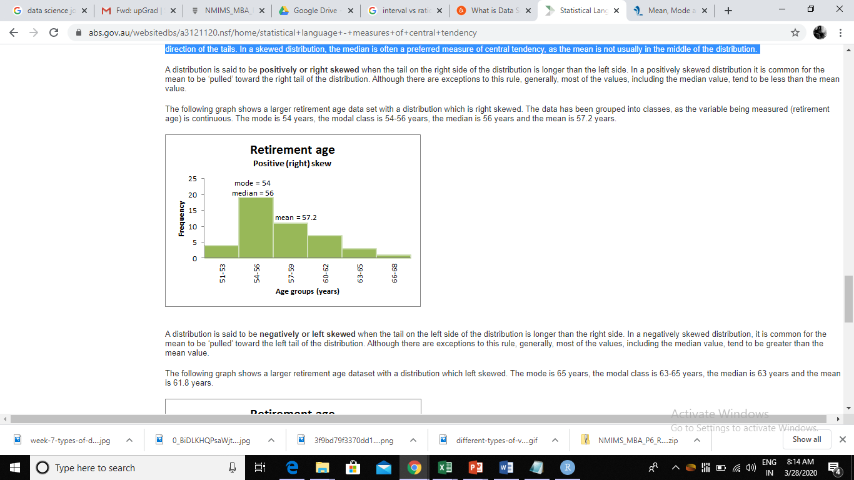
Skewed distributions: Skewness is the tendency for the values to be more frequent around the high or low ends of the x-axis.
mean is generally ‘pulled’ in the direction of the tails.
In a skewed distribution, the median is often a preferred measure of central tendency, as the mean is not usually in the middle of the distribution.
A distribution is said to be positively or right skewed when the tail on the right side of the distribution is longer than the left side.
In a positively skewed distribution it is common for the mean to be ‘pulled’ toward the right tail of the distribution

Slide 23
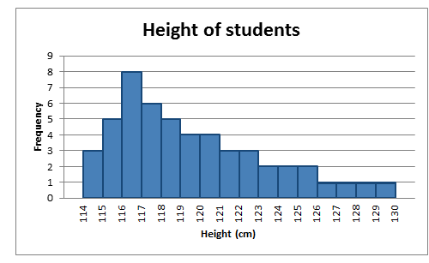
A distribution is said to be positively skewed when the tail on the right side of the histogram is longer than the left side.
Most of the values tend to cluster toward the left side of the x-axis (i.e. the smaller values) with increasingly fewer values at the right side of the x-axis (i.e. the larger values).

Slide 24
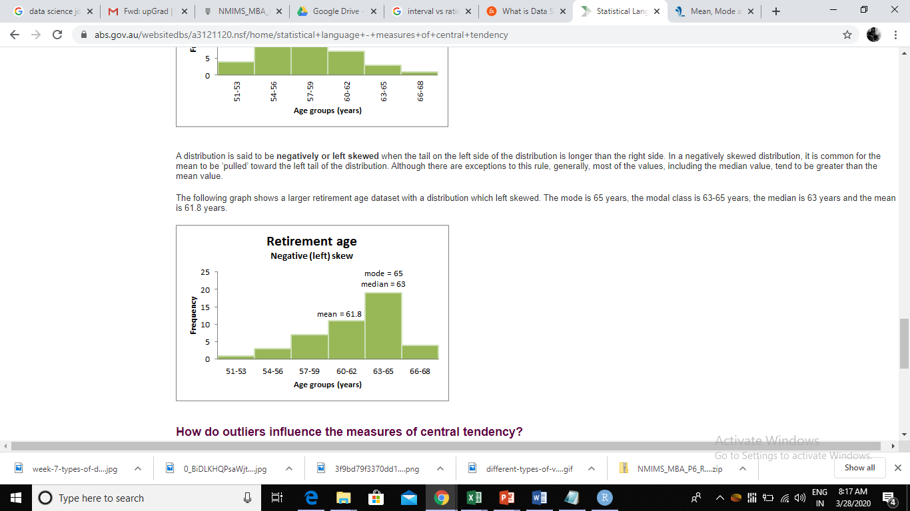
left skewed distribution
A distribution is said to be negatively or left skewed when the tail on the left side of the distribution is longer than the right side.
In a negatively skewed distribution, it is common for the mean to be ‘pulled’ toward the left tail of the distribution.
Although there are exceptions to this rule, generally, most of the values, including the median value, tend to be greater than the mean value.

Slide 25
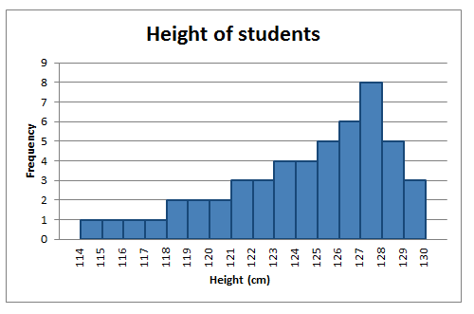
A distribution is said to be negatively skewed when the tail on the left side of the histogram is longer than the right side.
Most of the values tend to cluster toward the right side of the x-axis (i.e. the larger values), with increasingly less values on the left side of the x-axis (i.e. the smaller values).

Slide 26
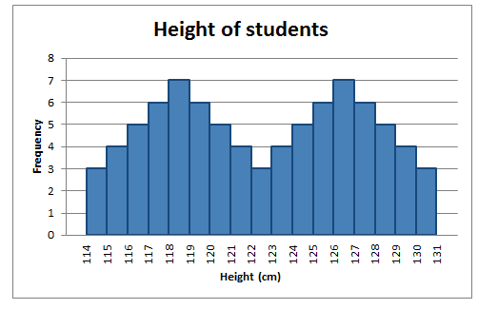
Identify the shape of following distribution

Slide 27
Simple random sampling
One of the best probability sampling techniques that helps in saving time and resources, is the Simple Random Sampling method.
It is a reliable method of obtaining information where every single member of a population is chosen randomly, merely by chance.
Each individual has the same probability of being chosen to be a part of a sample.
For example, in an organization of 500 employees, if the HR team decides on conducting team building activities, it is highly likely that they would prefer picking chits out of a bowl. In this case, each of the 500 employees has an equal opportunity of being selected.

Slide 28
Cluster sampling
Cluster sampling is a method where the researchers divide the entire population into sections or clusters that represent a population.
Clusters are identified and included in a sample based on demographic parameters like age, sex, location, etc.
This makes it very simple for a survey creator to derive effective inference from the feedback. For example, if the United States government wishes to evaluate the number of immigrants living in the Mainland US, they can divide it into clusters based on states such as California, Texas, Florida, Massachusetts, Colorado, Hawaii, etc. This way of conducting a survey will be more effective as the results will be organized into states and provide insightful immigration data.

Slide 29
Systematic sampling
Researchers use the systematic sampling method to choose the sample members of a population at regular intervals.
It requires the selection of a starting point for the sample and sample size that can be repeated at regular intervals. This type of sampling method has a predefined range, and hence this sampling technique is the least time-consuming.
For example, a researcher intends to collect a systematic sample of 500 people in a population of 5000. He/she numbers each element of the population from 1-5000 and will choose every 10th individual to be a part of the sample (Total population/ Sample Size = 5000/500 = 10).

Slide 30
Stratified random sampling
Stratified random sampling is a method in which the researcher divides the population into smaller groups that don’t overlap but represent the entire population.
While sampling, these groups can be organized and then draw a sample from each group separately. For example, a researcher looking to analyze the characteristics of people belonging to different annual income divisions will create strata (groups) according to the annual family income. Eg – less than $20,000, $21,000 – $30,000, $31,000 to $40,000, $41,000 to $50,000, etc.
By doing this, the researcher concludes the characteristics of people belonging to different income groups. Marketers can analyze which income groups to target and which ones to eliminate to create a roadmap that would bear fruitful results.

Slide 31
Uses of probability sampling
Reduce Sample Bias
Diverse Population
Create an Accurate Sample

Slide 32
non-probability sampling with examples
is a sampling method that involves a collection of feedback based on a researcher or statistician’s sample selection capabilities and not on a fixed selection process.
In most situations, the output of a survey conducted with a non-probable sample leads to skewed results, which may not represent the desired target population.

Slide 33
Convenience sampling:
This method is dependent on the ease of access to subjects such as surveying customers at a mall or passers-by on a busy street. It is usually termed as convenience sampling, because of the researcher’s ease of carrying it out and getting in touch with the subjects.
Researchers have nearly no authority to select the sample elements, and it’s purely done based on proximity and not representativeness.
This non-probability sampling method is used when there are time and cost limitations in collecting feedback. In situations where there are resource limitations such as the initial stages of research, convenience sampling is used.
For example, startups and NGOs usually conduct convenience sampling at a mall to distribute leaflets of upcoming events or promotion of a cause – they do that by standing at the mall entrance and giving out pamphlets randomly.

Slide 34
Judgmental or purposive sampling
Judgemental or purposive samples are formed by the discretion of the researcher. Researchers purely consider the purpose of the study, along with the understanding of the target audience.
For instance, when researchers want to understand the thought process of people interested in studying for their master’s degree. The selection criteria will be: “Are you interested in doing your masters in …?” and those who respond with a “No” are excluded from the sample
Snowball sampling: is a sampling method that researchers apply when the subjects are difficult to trace.
Quota sampling: the selection of members in this sampling technique happens based on a pre-set standard.

Slide 35
Normal Distribution
Normal distribution, also known as the Gaussian distribution, is a probability distribution that is symmetric about the mean, showing that data near the mean are more frequent in occurrence than data far from the mean. In graph form, normal distribution will appear as a bell curve.
KEY TAKEAWAYS
A normal distribution is the proper term for a probability bell curve.
In a normal distribution the mean is zero and the standard deviation is 1. It has zero skew and a kurtosis of 3.
Normal distributions are symmetrical, but not all symmetrical distributions are normal.
In reality, most pricing distributions are not perfectly normal.

Slide 36
Normal distribution
The standard normal distribution has two parameters: the mean and the standard deviation. For a normal distribution, 68% of the observations are within +/- one standard deviation of the mean, 95% are within +/- two standard deviations, and 99.7% are within +- three standard deviations.

Slide 37
Measures of dispersion
Suppose two machines produce nails which are on average 10 inches long. A sample of 11 nails is selected from each machine.
Machine A: 6, 8, 8, 10, 10, 10, 10, 10, 12, 12, 14
Machine B: 6, 6, 6, 8, 8, 10, 12, 12, 14, 14, 14
To verify, let's compute the mean:
mean for machine A: 110 / 11 = 10
mean for machine B: 110 / 11 = 10
In both cases, the mean is 10, indeed. However, the first machine seems to be the better one, since most nails are close to 10 inches. Therefore:
We must find additional numbers indicating the 'spread' of the data.

Slide 38
The Range
The easiest measure of the data spread is the range.
It is simply the highest data value minus the lowest data value (we have seen the range before). In the above example, the range is the same for both data, namely 14 - 6 = 8.
The range is, while useful, too crude a measure of variability.

Slide 39
The Variance
We want to find out how much the data points are spread around the mean. To do that, we could find the difference between each data point and the mean, and average these differences.
However, we want to measure the differences to the mean regardless of the sign (positive or negative difference).
Therefore, we could find the absolute value of the difference between each data point and average that.
we will use this formula to compute the data spread, or variance:
Variance = add up the squares of (Data points - mean), then divide that sum by n or n-1

Slide 40
How to find the variance "by hand":
Make a table of all x values
Find the mean of the data
Include a column with the difference to the mean
Include a column with the square of difference to the mean
Add the last column and divide the sum by (n - 1).

Slide 41
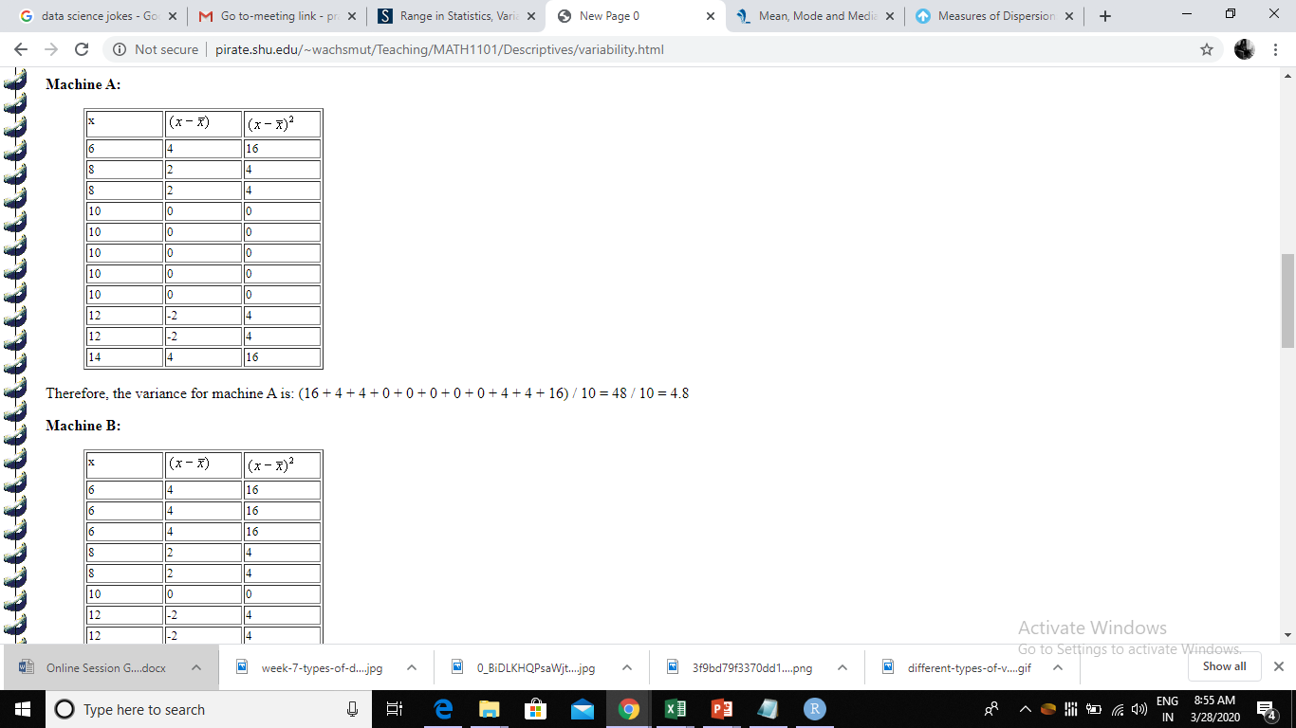

Slide 42
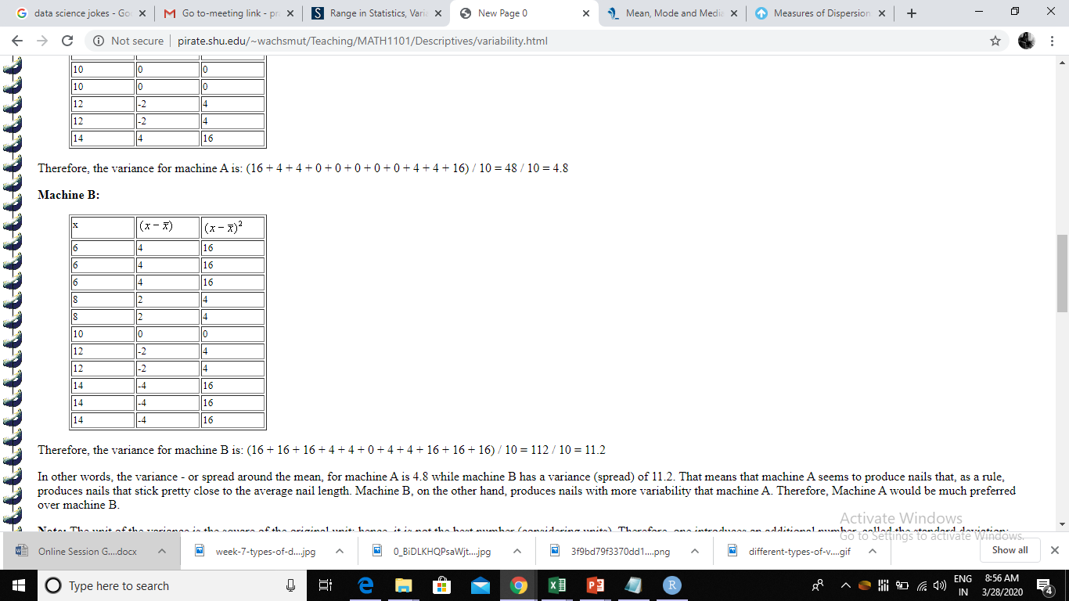

Slide 43
Conclusion
variance - or spread around the mean, for machine A is 4.8 while machine B has a variance (spread) of 11.2.
That means that machine A seems to produce nails that, as a rule, produces nails that stick pretty close to the average nail length.
Machine B, on the other hand, produces nails with more variability that machine A.
Therefore, Machine A would be much preferred over machine B.

Slide 44
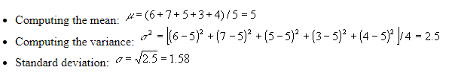
The Standard Deviation
The standard deviation is the square root of the variance.
Consider the sample data 6, 7, 5, 3, 4. Compute the standard deviation for that data.

Slide 45
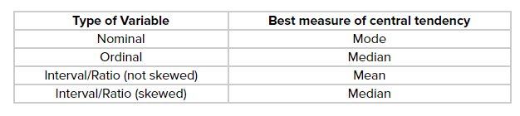
Summary of when to use the mean, median and mode

Slide 46
Skewness
Skewness, in statistics, is the degree of asymmetry observed in a probability distribution.
Distributions can exhibit right (positive) skewness or left (negative) skewness to varying degrees. A normal distribution (bell curve) exhibits zero skewness.
The mean of positively skewed data will be greater than the median. In a distribution that is negatively skewed, the exact opposite is the case: the mean of negatively skewed data will be less than the median. If the data graphs symmetrically, the distribution has zero skewness, regardless of how long or fat the tails are.

Slide 47
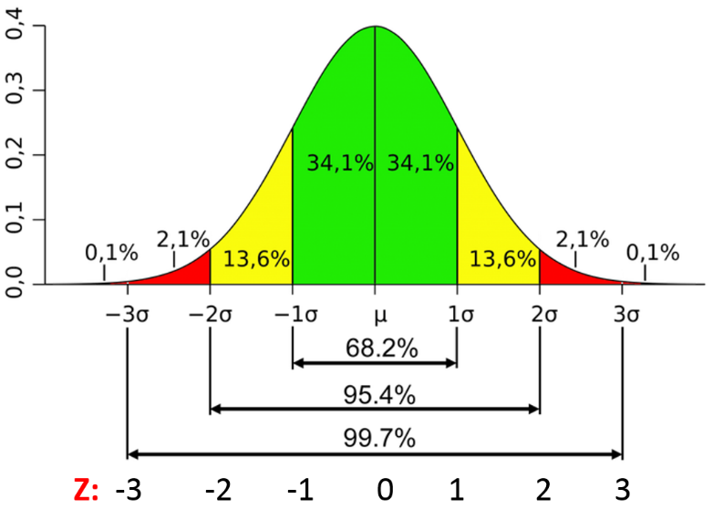

Slide 48
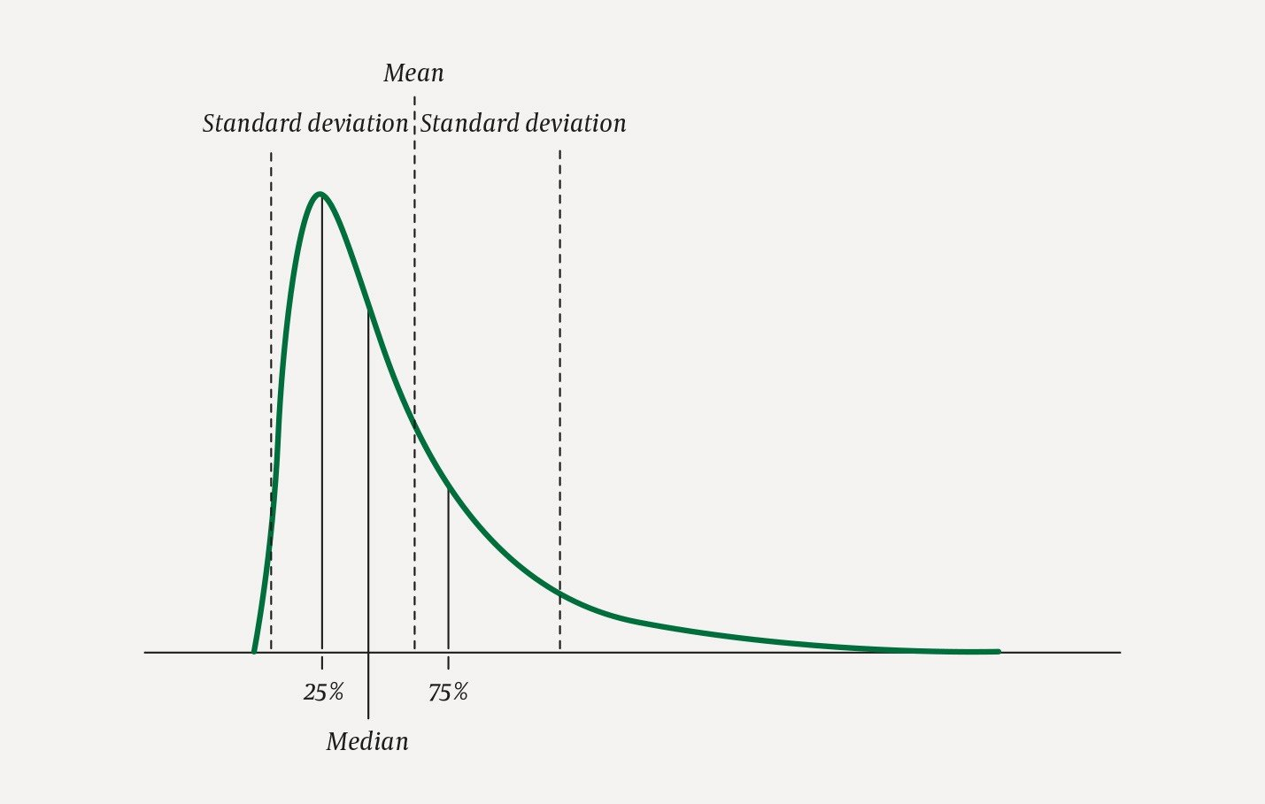

Slide 49
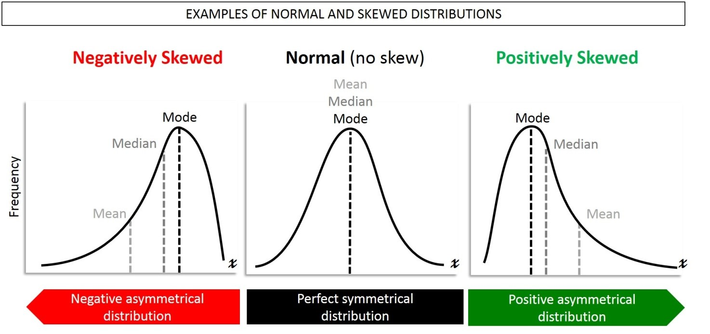

Slide 50
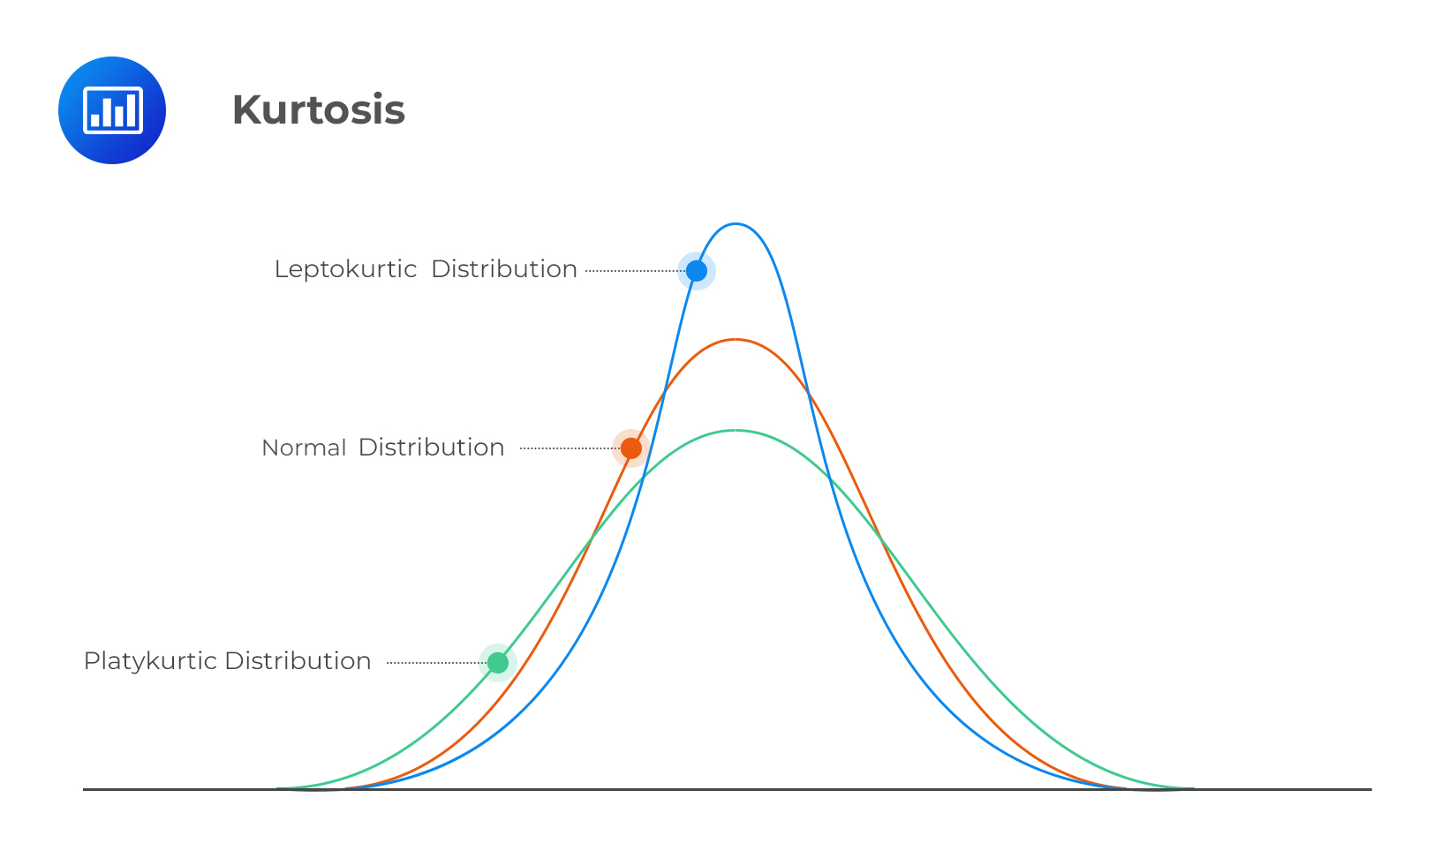

Slide 51
What is a Correlation
A correlation is a statistical measure of the relationship between two variables.
The measure is best used in variables that demonstrate a linear relationship between each other.
The correlation coefficient is a value that indicates the strength of the relationship between variables. The coefficient can take any values from -1 to 1. The interpretations of the values are:
-1: Perfect negative correlation. The variables tend to move in opposite directions (i.e., when one variable increases, the other variable decreases).
0: No correlation. The variables do not have a relationship with each other.
1: Perfect positive correlation. The variables tend to move in the same direction (i.e., when one variable increases, the other variable also increases).

Slide 52
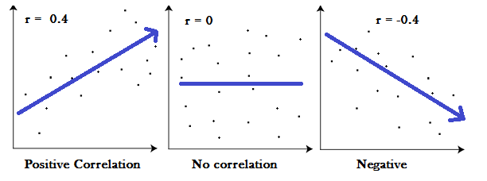

Slide 53
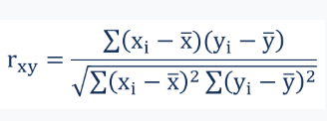
How to Find the Correlation?
Where:
r_{xy} – the correlation coefficient of the linear relationship between the variables x and y
x_{i} – the values of the x-variable in a sample
x̅ – the mean of the values of the x-variable
y_{i} – the values of the y-variable in a sample
ȳ – the mean of the values of the y-variable

Slide 54
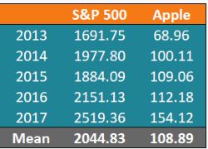
Calculation

Slide 55
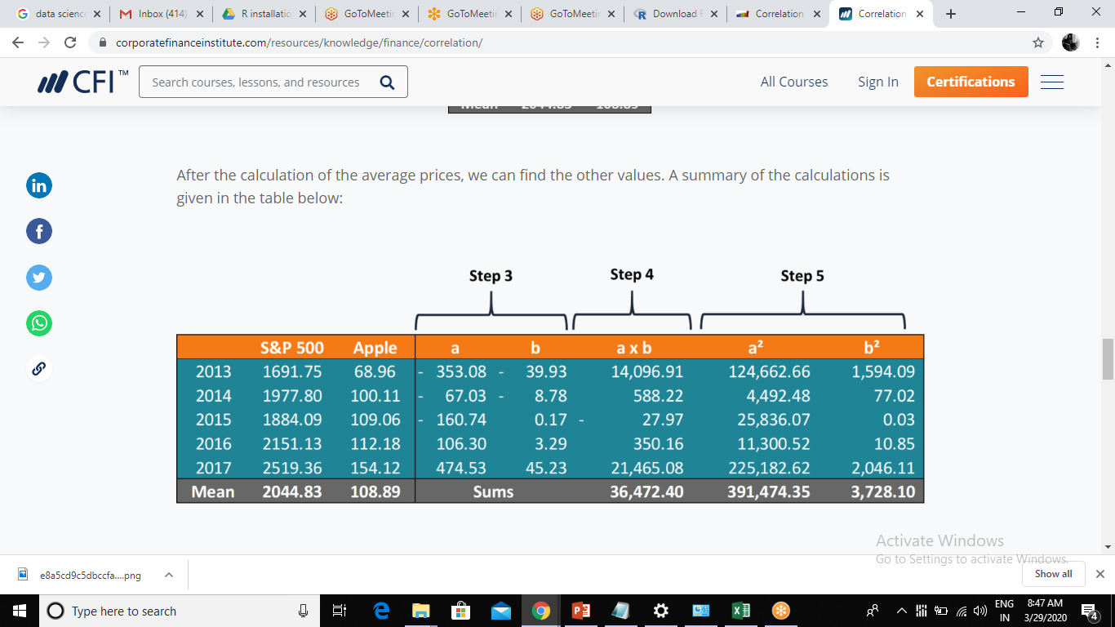

Slide 56
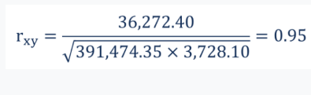

Slide 57
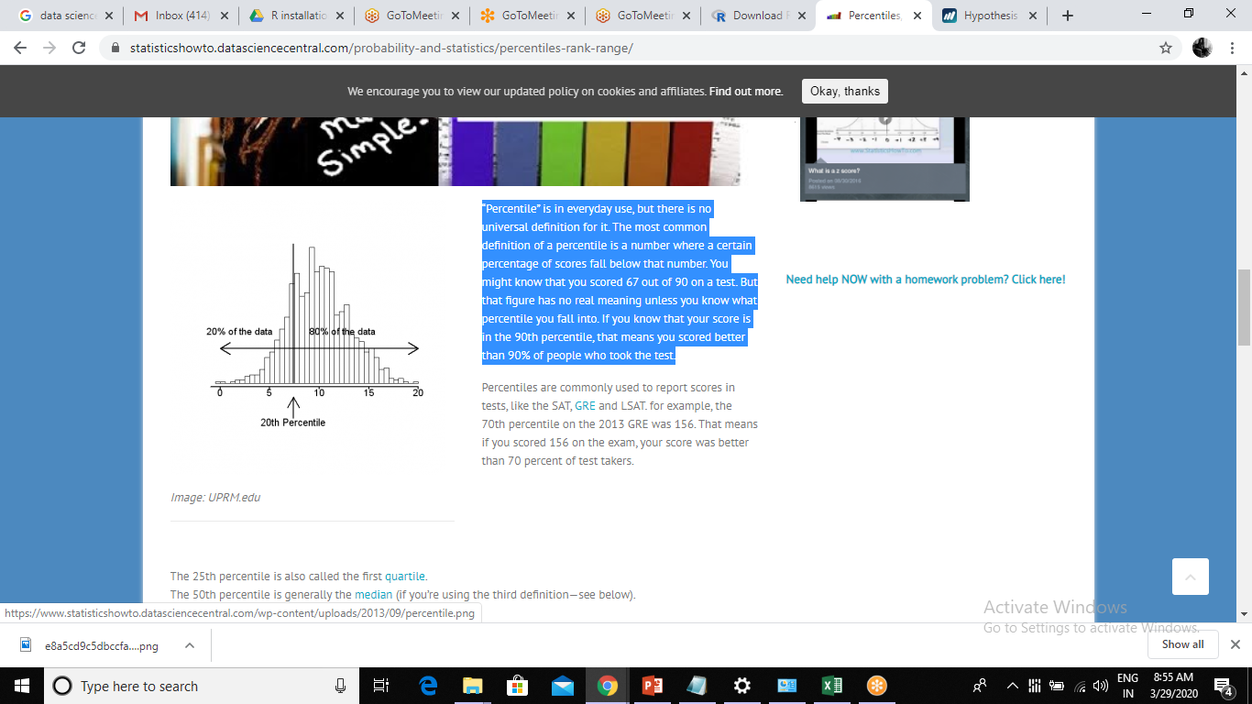
Percentiles
“Percentile” is in everyday use, but there is no universal definition for it. The most common definition of a percentile is a number where a certain percentage of scores fall below that number.
If you know that your score is in the 90th percentile, that means you scored better than 90% of people who took the test.

Slide 58
The 25th percentile is also called the first quartile.
The 50th percentile is generally the median
The 75th percentile is also called the third quartile.
The difference between the third and first quartiles is the interquartile range.

Slide 59
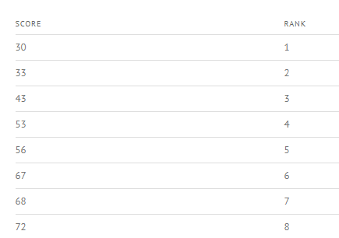
The nth percentile is the smallest score that is greater than or equal to a certain percentage of the scores. To rephrase this, it’s the percentage of data that falls at or below a certain observation.
In this example, the 25th percentile is the score that’s greater or equal to 25% of the scores.

Slide 60
Calculation of percentile
Calculate what rank is at the 25th percentile. Use the following formula:
Rank = Percentile / 100 * (number of items + 1)
Rank = 25 / 100 * (8 + 1) = 0.25 * 9 = 2.25.
A rank of 2.25 is at the 25th percentile. However, there isn’t a rank of 2.25 (ever heard of a high school rank of 2.25? I haven’t!), so you must either round up, or round down. As 2.25 is closer to 2 than 3, lets round down to a rank of 2.

Slide 61
What is Kurtosis
Kurtosis is a statistical measure that defines how heavily the tails of a distribution differ from the tails of a normal distribution.
In other words, kurtosis identifies whether the tails of a given distribution contain extreme values.
Mesokurtic: Distributions that are moderate in breadth and curves with a medium peaked height.
Leptokurtic: More values in the distribution tails and more values close to the mean (i.e. sharply peaked with heavy tails)
Platykurtic: Fewer values in the tails and fewer values close to the mean (i.e. the curve has a flat peak and has more dispersed scores with lighter tails).

Slide 62
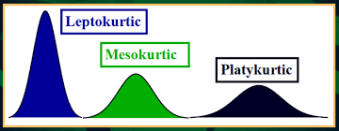

Slide 63
R Language
R is a language and environment for statistical computing and graphics
R provides a wide variety of statistical (linear and nonlinear modelling, classical statistical tests, time-series analysis, classification, clustering, …) and graphical techniques, and is highly extensible.
R is available as Free Software under the terms of the Free Software Foundation
a well-developed, simple and effective programming language which includes conditionals, loops, user-defined recursive functions and input and output facilities.
R can be extended (easily) via packages. There are about eight packages supplied with the R distribution and many more are available through the CRAN[Comprehensive R Archival Network]

Slide 64
Variable in R
Variables are used to store data, whose value can be changed according to our need.
Identifiers can be a combination of letters, digits, period (.) and underscore (_).
It must start with a letter or a period. If it starts with a period, it cannot be followed by a digit.
Reserved words in R cannot be used as identifiers.

Slide 65
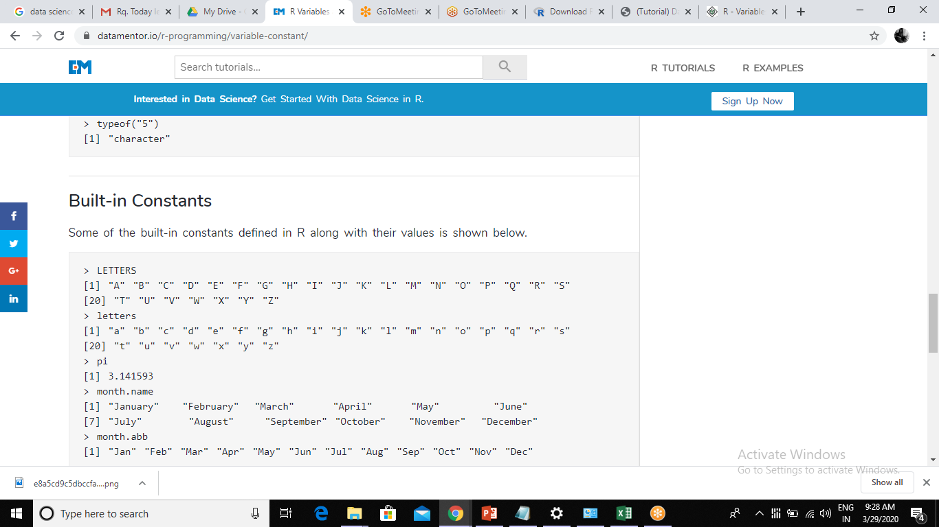
Constants in R
Constants, as the name suggests, are entities whose value cannot be altered.
Some of the built-in constants defined in R along with their values is shown below.

Slide 66
Basic Data Types in R
Numeric: Numbers that have a decimal value or are a fraction in nature have a data type as numeric.
Integer: Numbers that do not contain decimal values have a data type as an integer.
Character: As the name suggests, it can be a letter or a combination of letters enclosed by quotes is considered as a character data type by R. It can be alphabets or numbers.
Logical: A variable that can have a value of True and False like a Boolean is called a logical variable.
Complex : A variable that can be presented in form of complex number

Slide 67
Collective Data Types in R
Vector
Data Frame
Factor *
List
Matrix
Array

Slide 68
Hypothesis testing
H₀: The null hypothesis: It is a statement about the population that either is believed to be true or is used to put forth an argument unless it can be shown to be incorrect beyond a reasonable doubt.
H_{a}: The alternative hypothesis: It is a claim about the population that is contradictory to H₀ and what we conclude when we reject H₀.

Slide 69
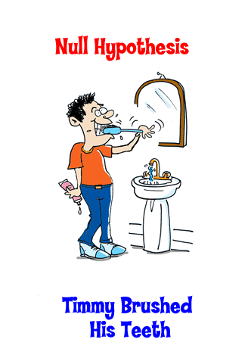

Slide 70
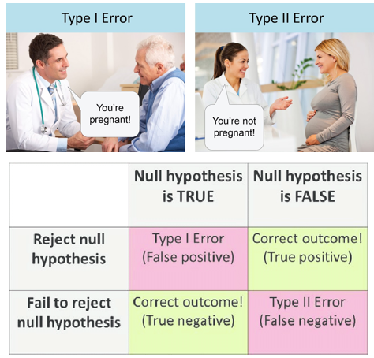
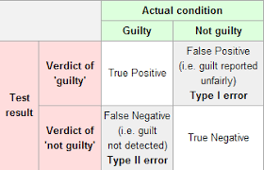
Type I and Type II errors

Slide 71

Supervised vs Unsupervised Machine Learning

Slide 72
THANK YOU

